Slide 1
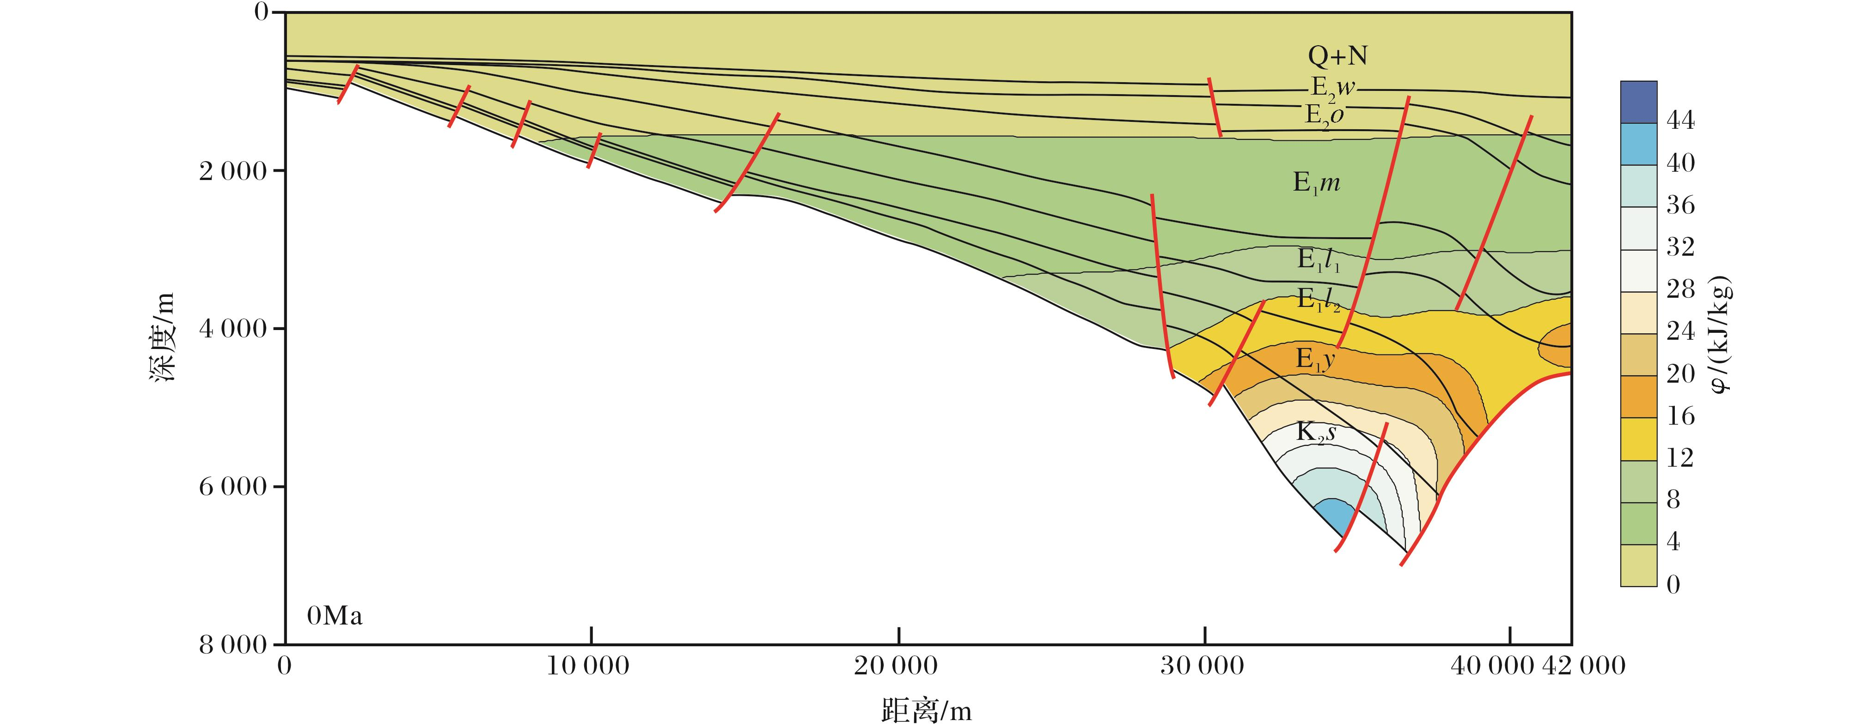
图8 丽水凹陷Inline-W155测线现今油势分布特征(位置见图1)
Fig.8 Nowadays oil potential distribution of the Inline-W155 in Lishui Sag
Tian Yang，Ye Jiaren，Yang Baolin,et al.Hydrocarbon accumulation rule and exploration target optimization in Lishui Sag,East China Sea continental shelf basin[J].Natural Gas Geoscience,2016,27(4):639-653.[田杨，叶加仁，杨宝林,等.东海陆架盆地丽水凹陷油气成藏规律及区带优选[J].天然气地球科学，2016,27(4):639-653.]

