Slide 1
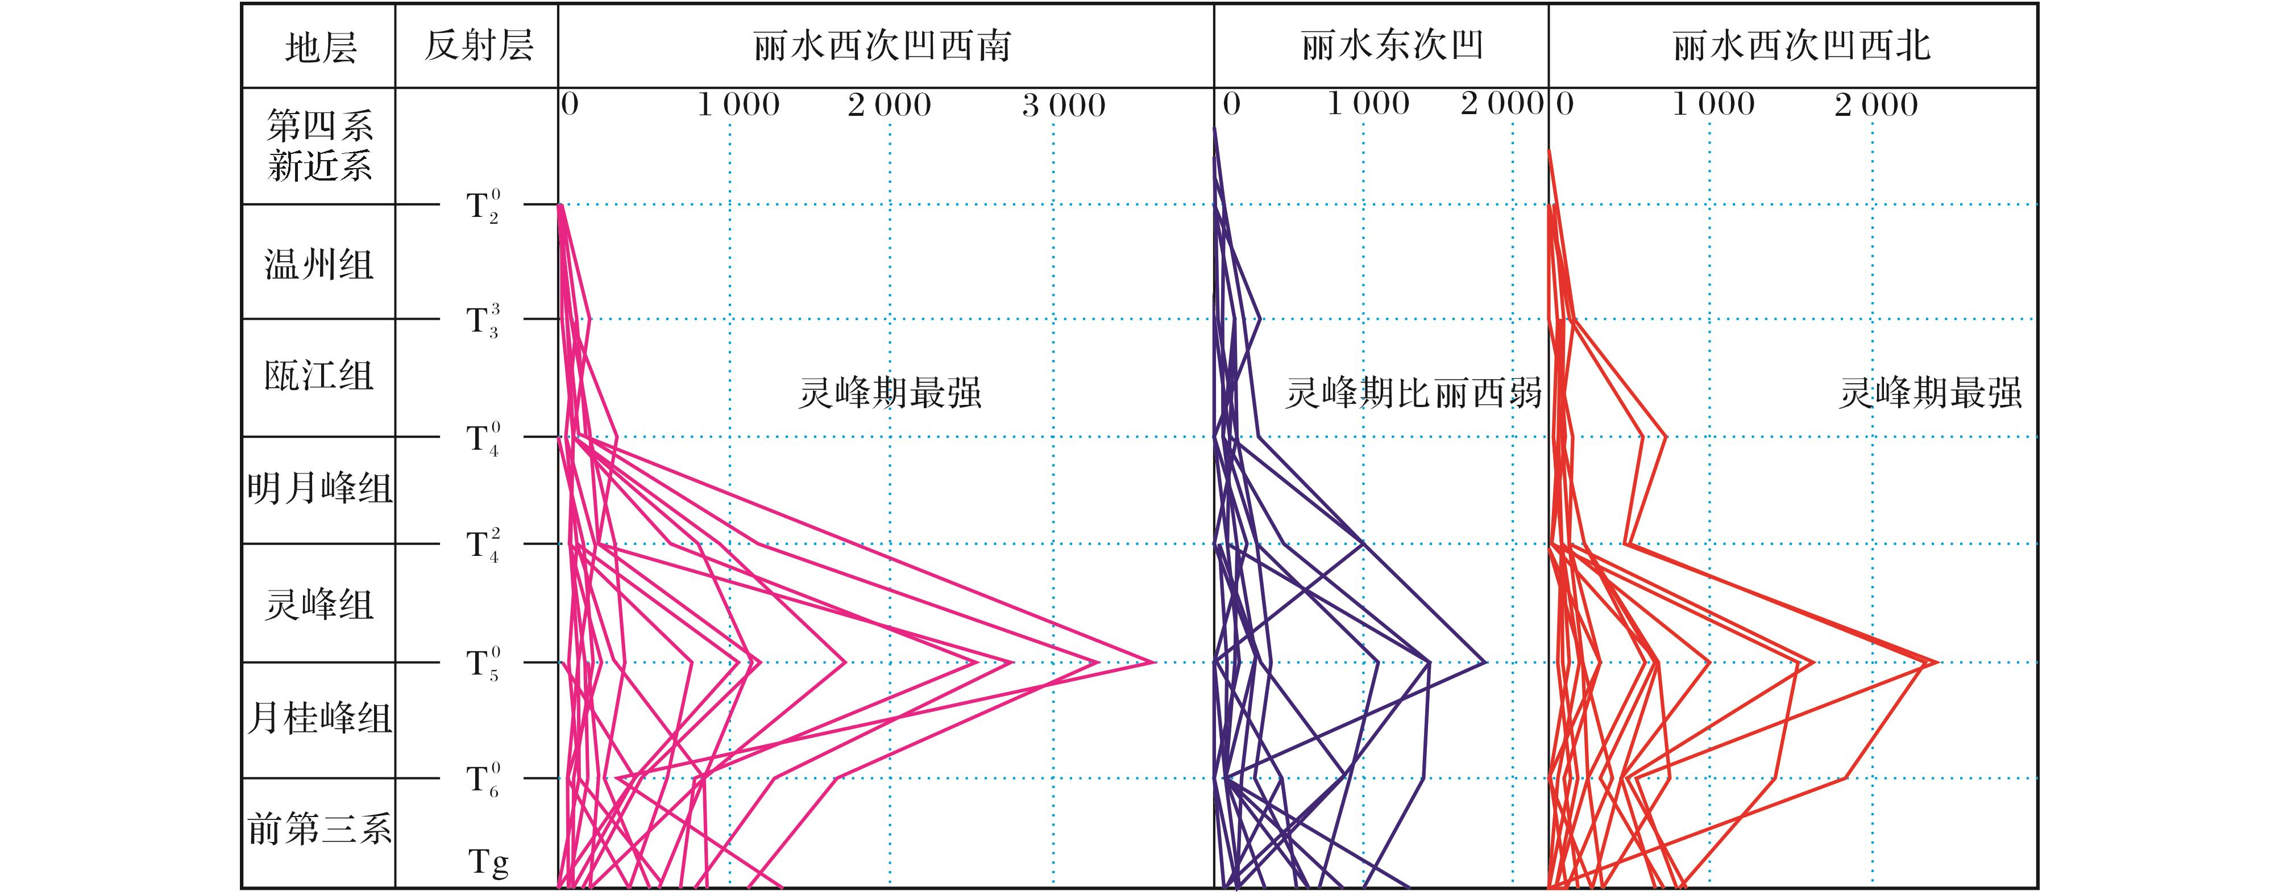
图7 丽水凹陷主要断裂活动强度统计曲线[注：横坐标(断距/m)]
Fig.7 Strength of main faults statistical in Lishui Sag
Tian Yang，Ye Jiaren，Yang Baolin,et al.Hydrocarbon accumulation rule and exploration target optimization in Lishui Sag,East China Sea continental shelf basin[J].Natural Gas Geoscience,2016,27(4):639-653.[田杨，叶加仁，杨宝林,等.东海陆架盆地丽水凹陷油气成藏规律及区带优选[J].天然气地球科学，2016,27(4):639-653.]

