Slide 1
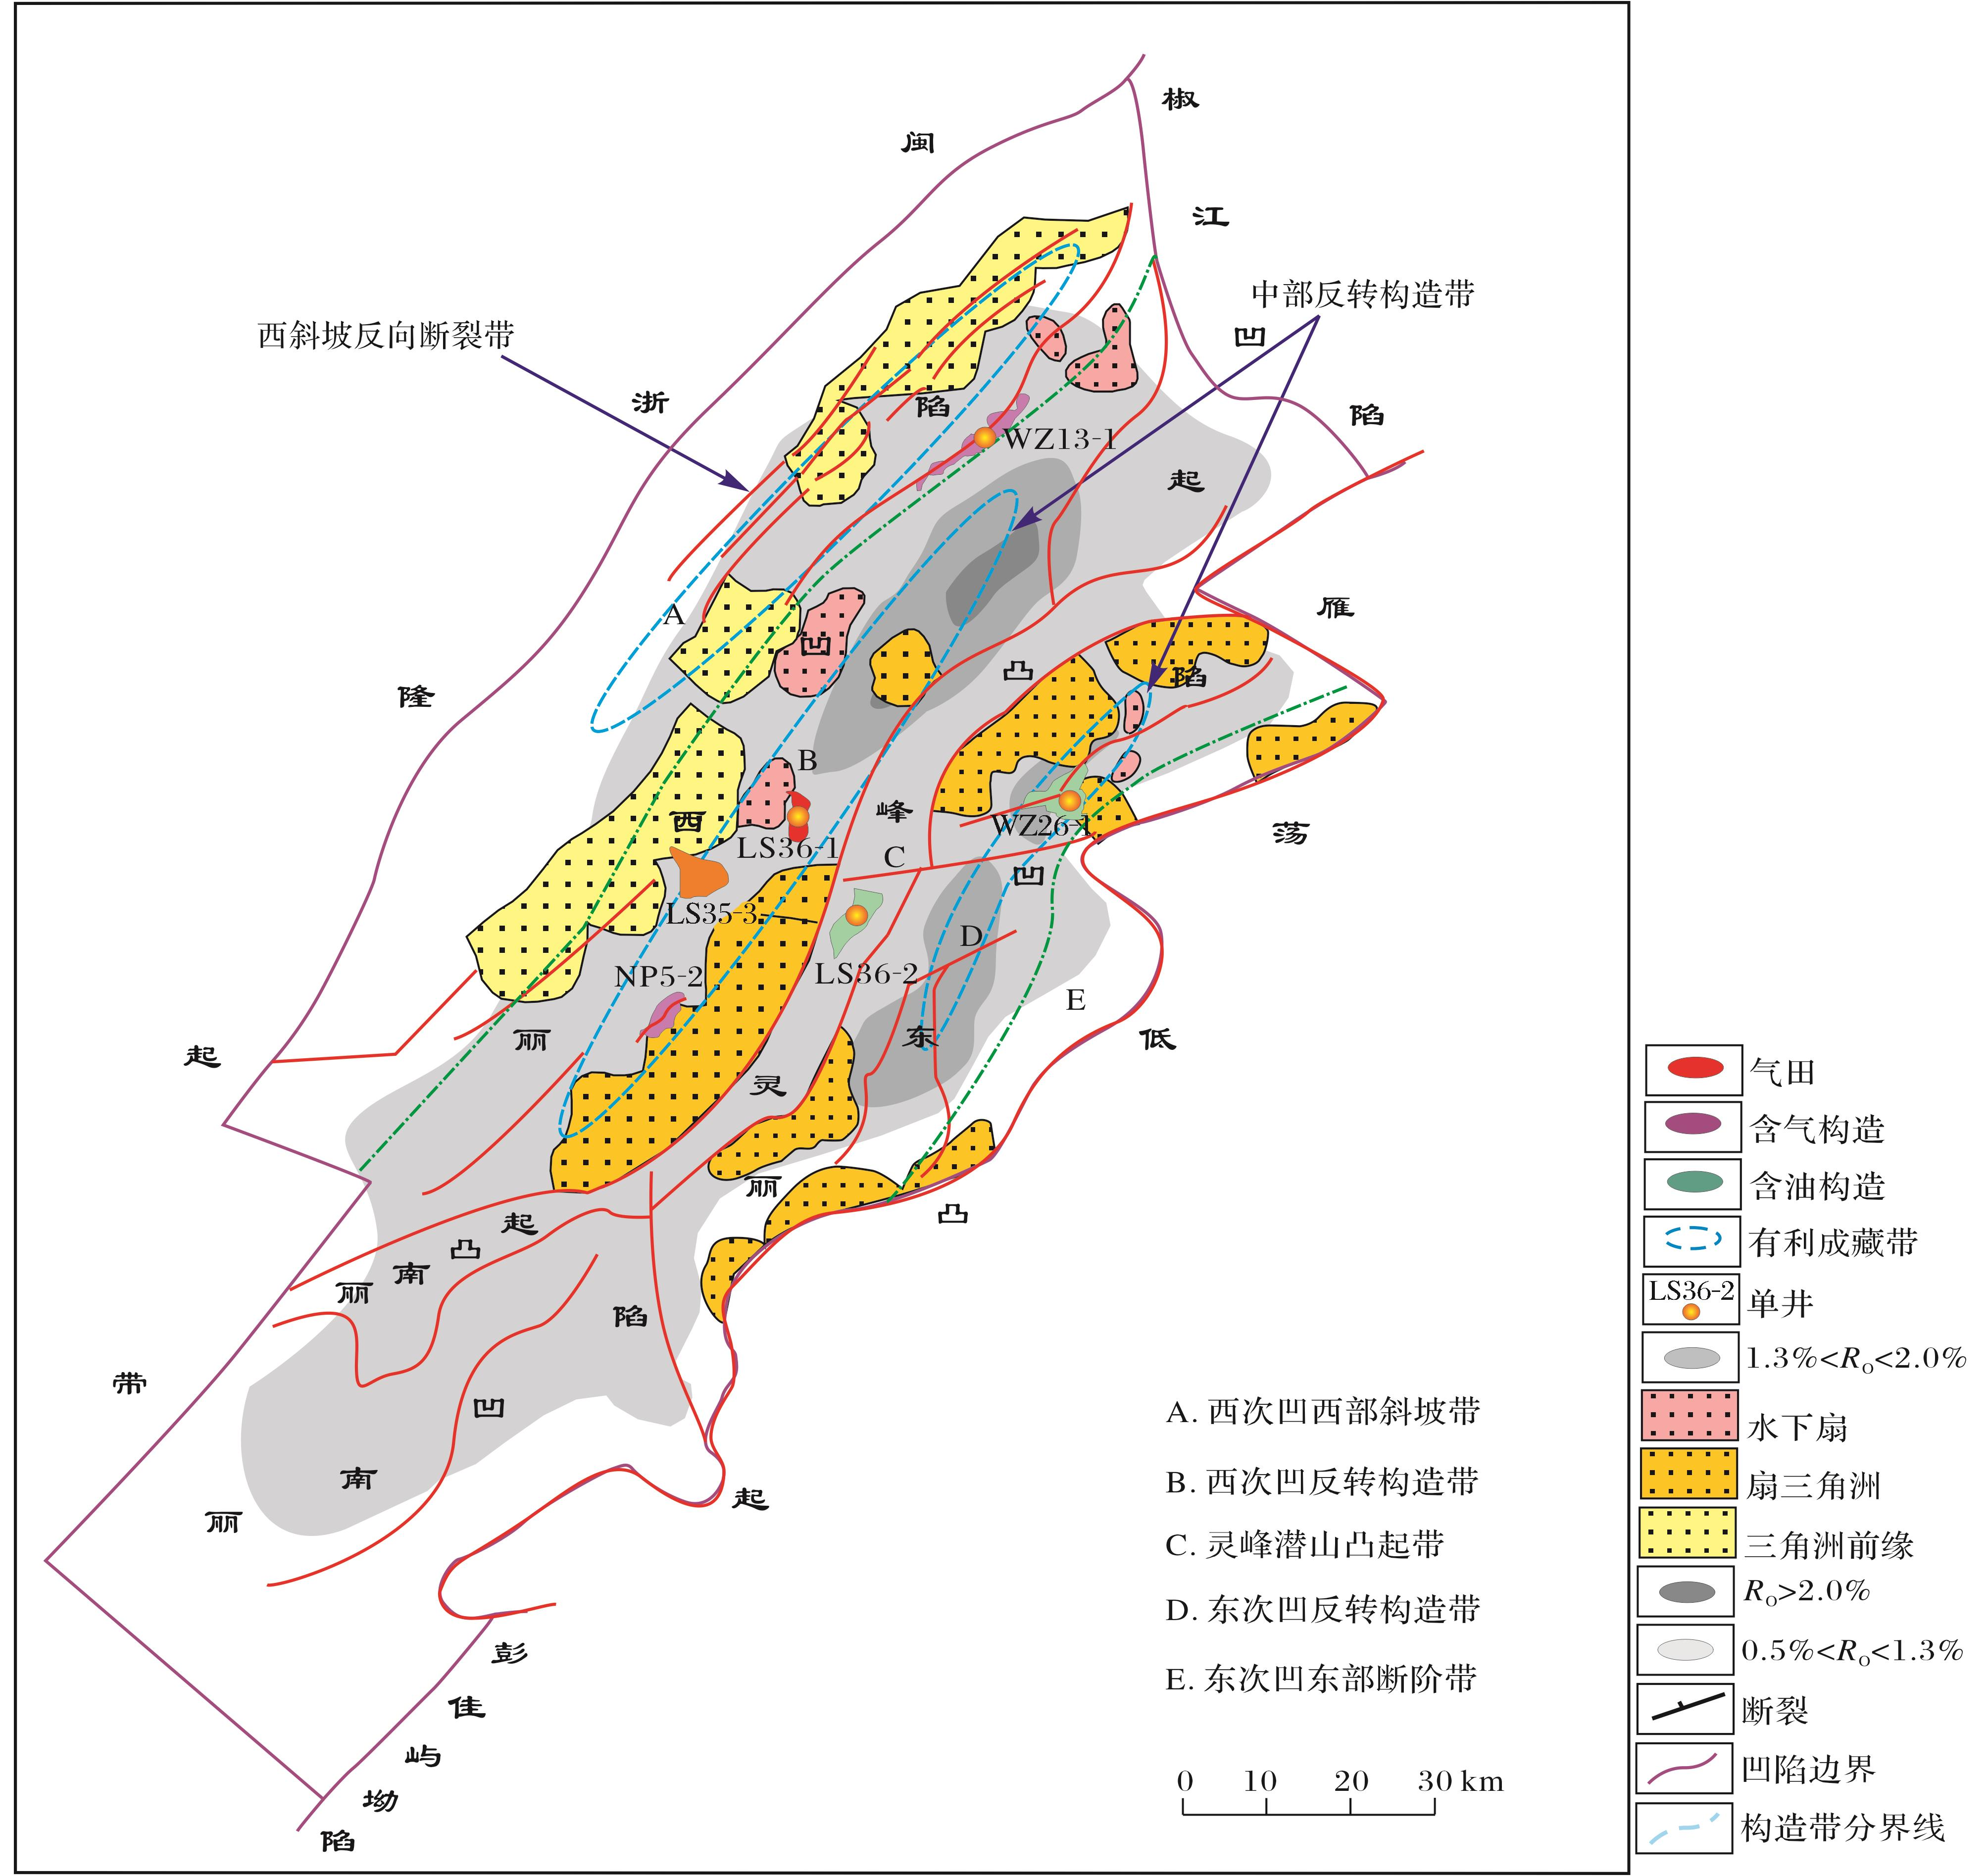
图12 丽水凹陷有利勘探区带划分
Fig.12 Division of the promising exploration belts in Lishui Sag
Tian Yang，Ye Jiaren，Yang Baolin,et al.Hydrocarbon accumulation rule and exploration target optimization in Lishui Sag,East China Sea continental shelf basin[J].Natural Gas Geoscience,2016,27(4):639-653.[田杨，叶加仁，杨宝林,等.东海陆架盆地丽水凹陷油气成藏规律及区带优选[J].天然气地球科学，2016,27(4):639-653.]

