Slide 1
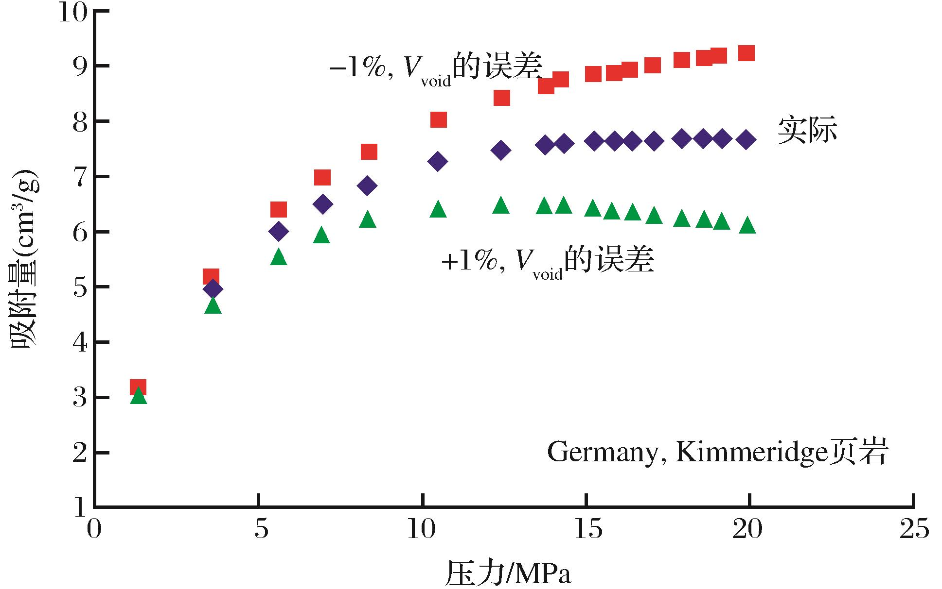
图4 自由空间体积对吸附量的影响
Fig.4 Diagram showing the effect of void volume on the methane adsorption capacity measurement on shale
Ma Xingzhi,Liu Shaobo,Jiang Lin,et al.Quantitative analysis on affecting factors of gas adsorption capacity measurement on the shale[J].Natural Gas Geoscience,2016,27(3):488-493.[马行陟,柳少波，姜林，等.页岩吸附气含量测定的影响因素定量分析[J].天然气地球科学，2016,27(3):488-493.]

