Slide 1
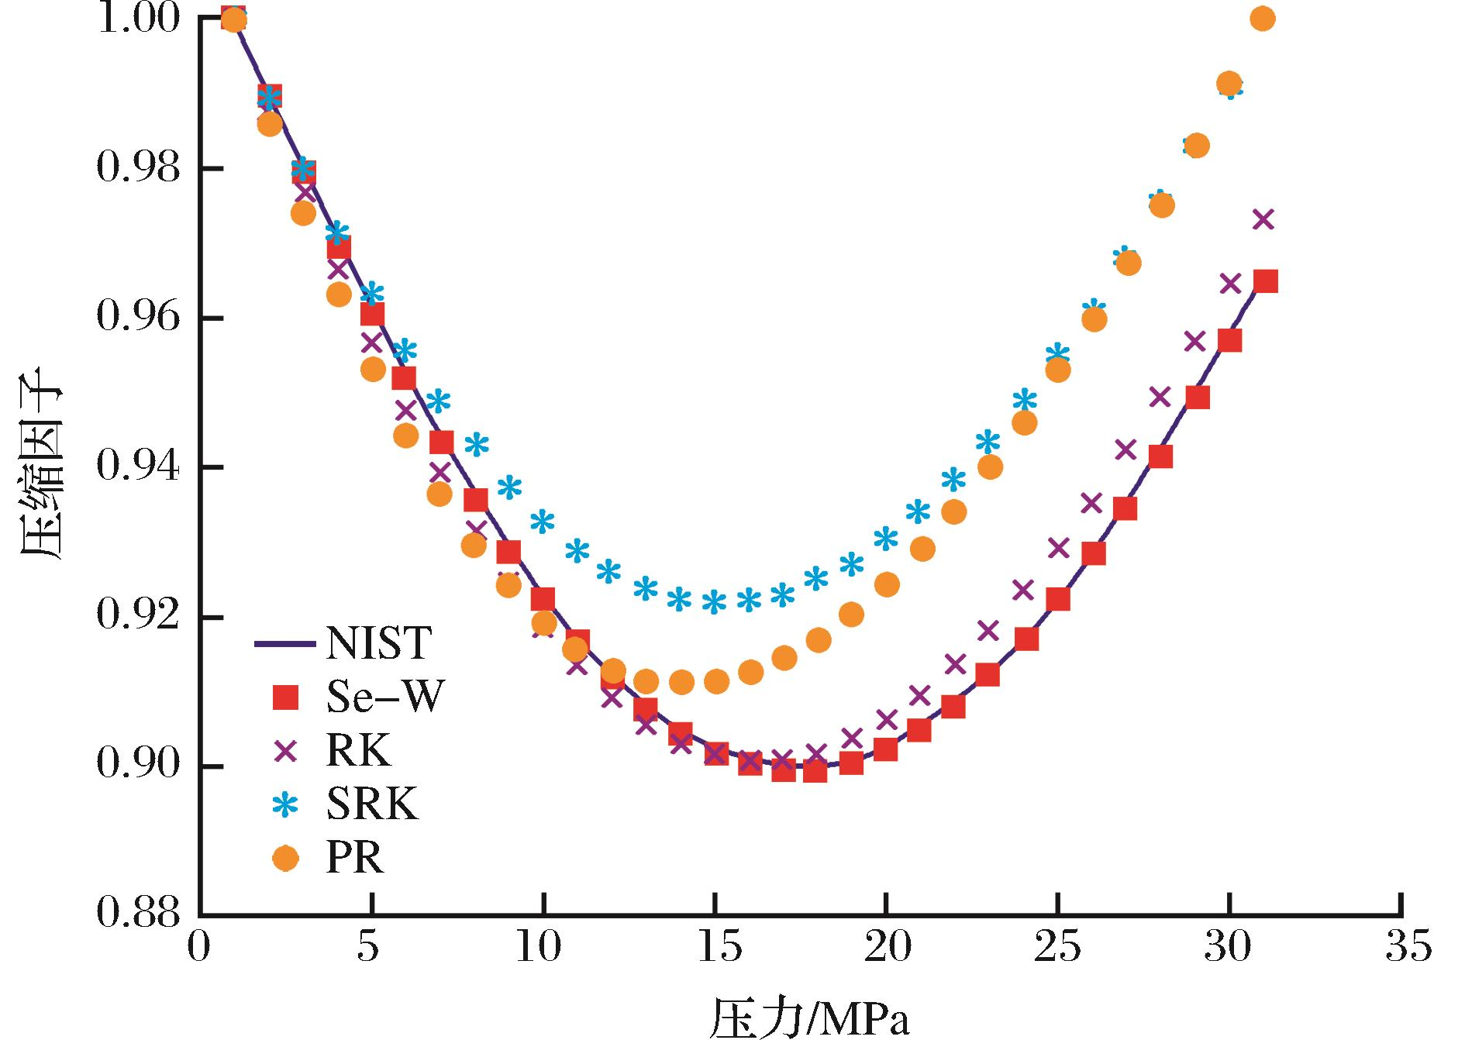
图2 不同状态方程计算的甲烷压缩因子与NIST标准数据的对比
Fig.2 Comparison of gas compression index calculated by different EOS equation and NIST standard data
Ma Xingzhi,Liu Shaobo,Jiang Lin,et al.Quantitative analysis on affecting factors of gas adsorption capacity measurement on the shale[J].Natural Gas Geoscience,2016,27(3):488-493.[马行陟,柳少波，姜林，等.页岩吸附气含量测定的影响因素定量分析[J].天然气地球科学，2016,27(3):488-493.]

