Slide 1
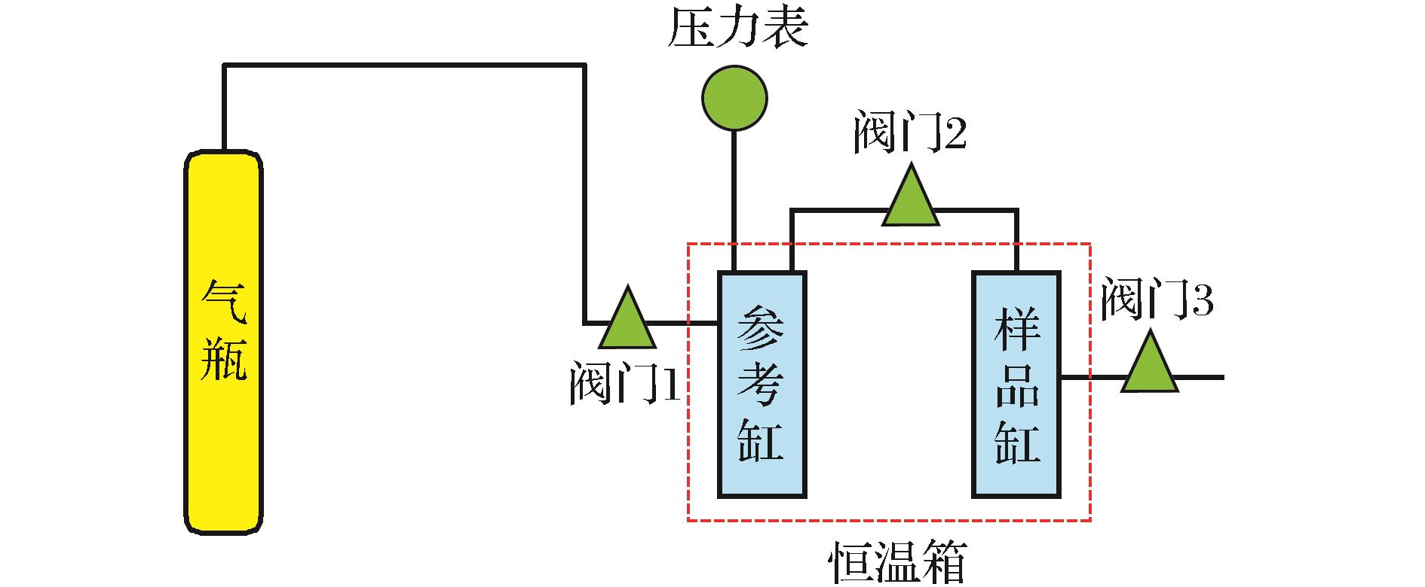
图1 压力计等温吸附实验原理
Fig.1 Schematic diagram of manometric isotherm adsorption equipment
Ma Xingzhi,Liu Shaobo,Jiang Lin,et al.Quantitative analysis on affecting factors of gas adsorption capacity measurement on the shale[J].Natural Gas Geoscience,2016,27(3):488-493.[马行陟,柳少波，姜林，等.页岩吸附气含量测定的影响因素定量分析[J].天然气地球科学，2016,27(3):488-493.]

