Slide 1
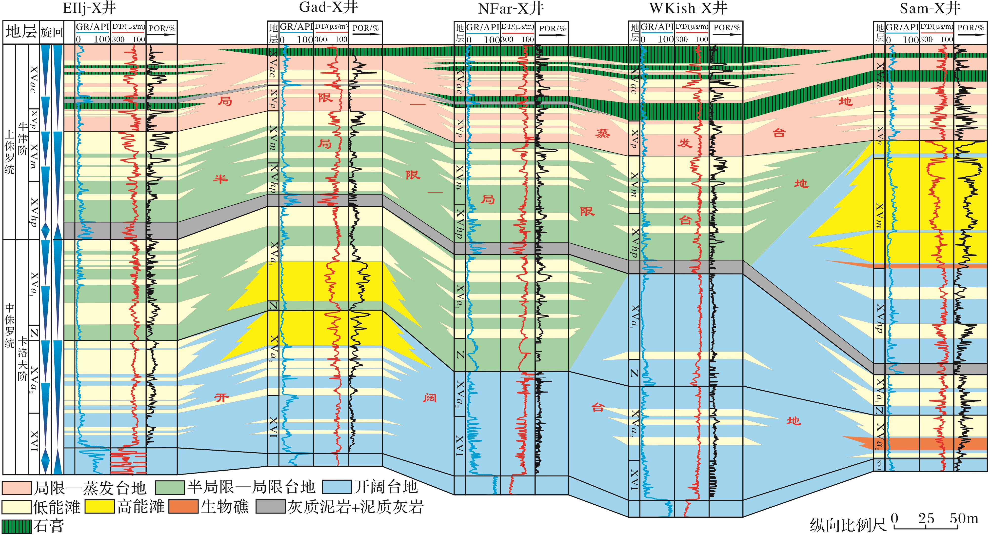
图5 阿姆河右岸地区西北部卡洛夫—牛津阶联井层序沉积相对比(剖面位置见图1)
Fig.5 Sequence stratigraphy and sedimentary facies correlation of Callovian-Oxfordian in the northwestern Amu Darya Right Bank area
Tian Yu，Zhang Xingyang，Zhu Guowei,et al.Controlling effects of paleogeomorphology on intraplatform shoal reservoirs distribution and gas reservoirs characteristics:Taking intraplatform shoal gasfields of the Amu Darya Basin as examples[J].Natural Gas Geoscience,2016,27(2):320-329.[田雨，张兴阳，朱国维，等.古地貌对台内滩储层分布及气藏特征的控制作用——以阿姆河盆地台内滩气田为例[J].天然气地球科学，2016,27(2):320-329.]

