Slide 1
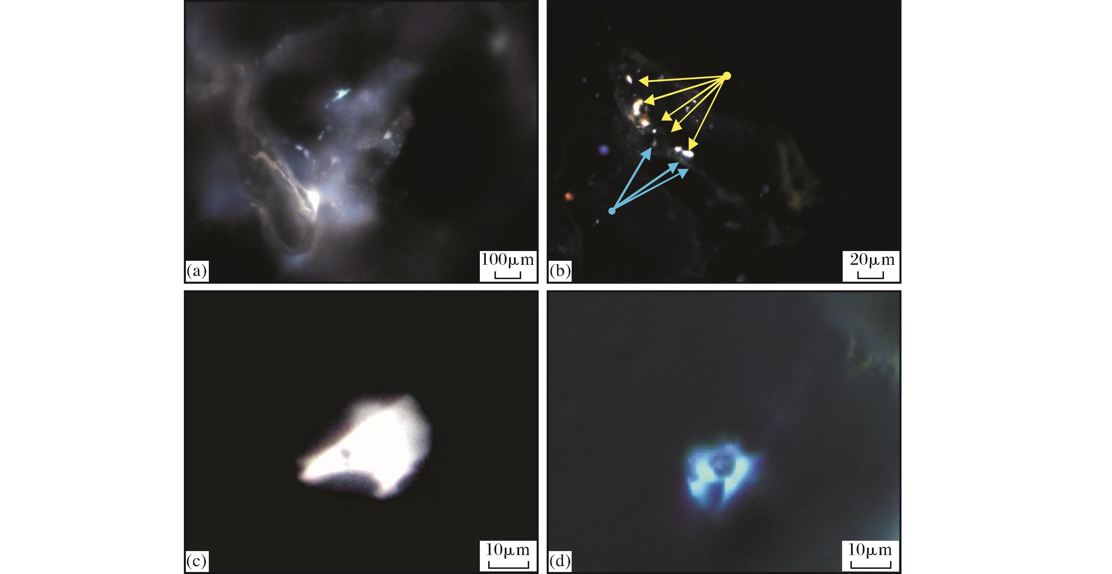
图5 烃类包裹体特征及赋存状态(跃检1井,3 232.4m)
Fig.5 Typical hydrocarbon inclusions and their occurrence(well Yuejian1,3 234m) (a)2类包裹体发育，紫外光(UV);(b)黄色荧光包裹体发育在石英次生加大前，气液比8%，UV;(c)黄色荧光油气包裹体，气液比5%，紫外光(UV);(d)黄绿色荧光油气包裹体，气液比8%，UV
Gui Lili,Zhao Mengjun,Liu Keyu,et al.Reservoir fluid evolution and hydrocarbon charge history of the Gasi E<sup>1</sup><sub>3</sub> Oilfield,southwestern Qaidam Basin[J].Natural Gas Geoscience,2016,27(2):289-297,319.[桂丽黎，赵孟军，刘可禹，等.柴达木盆地尕斯地区古近系砂岩储层流体—成藏演化特征[J].天然气地球科学，2016,27(2):289-297,319.]

