Slide 1
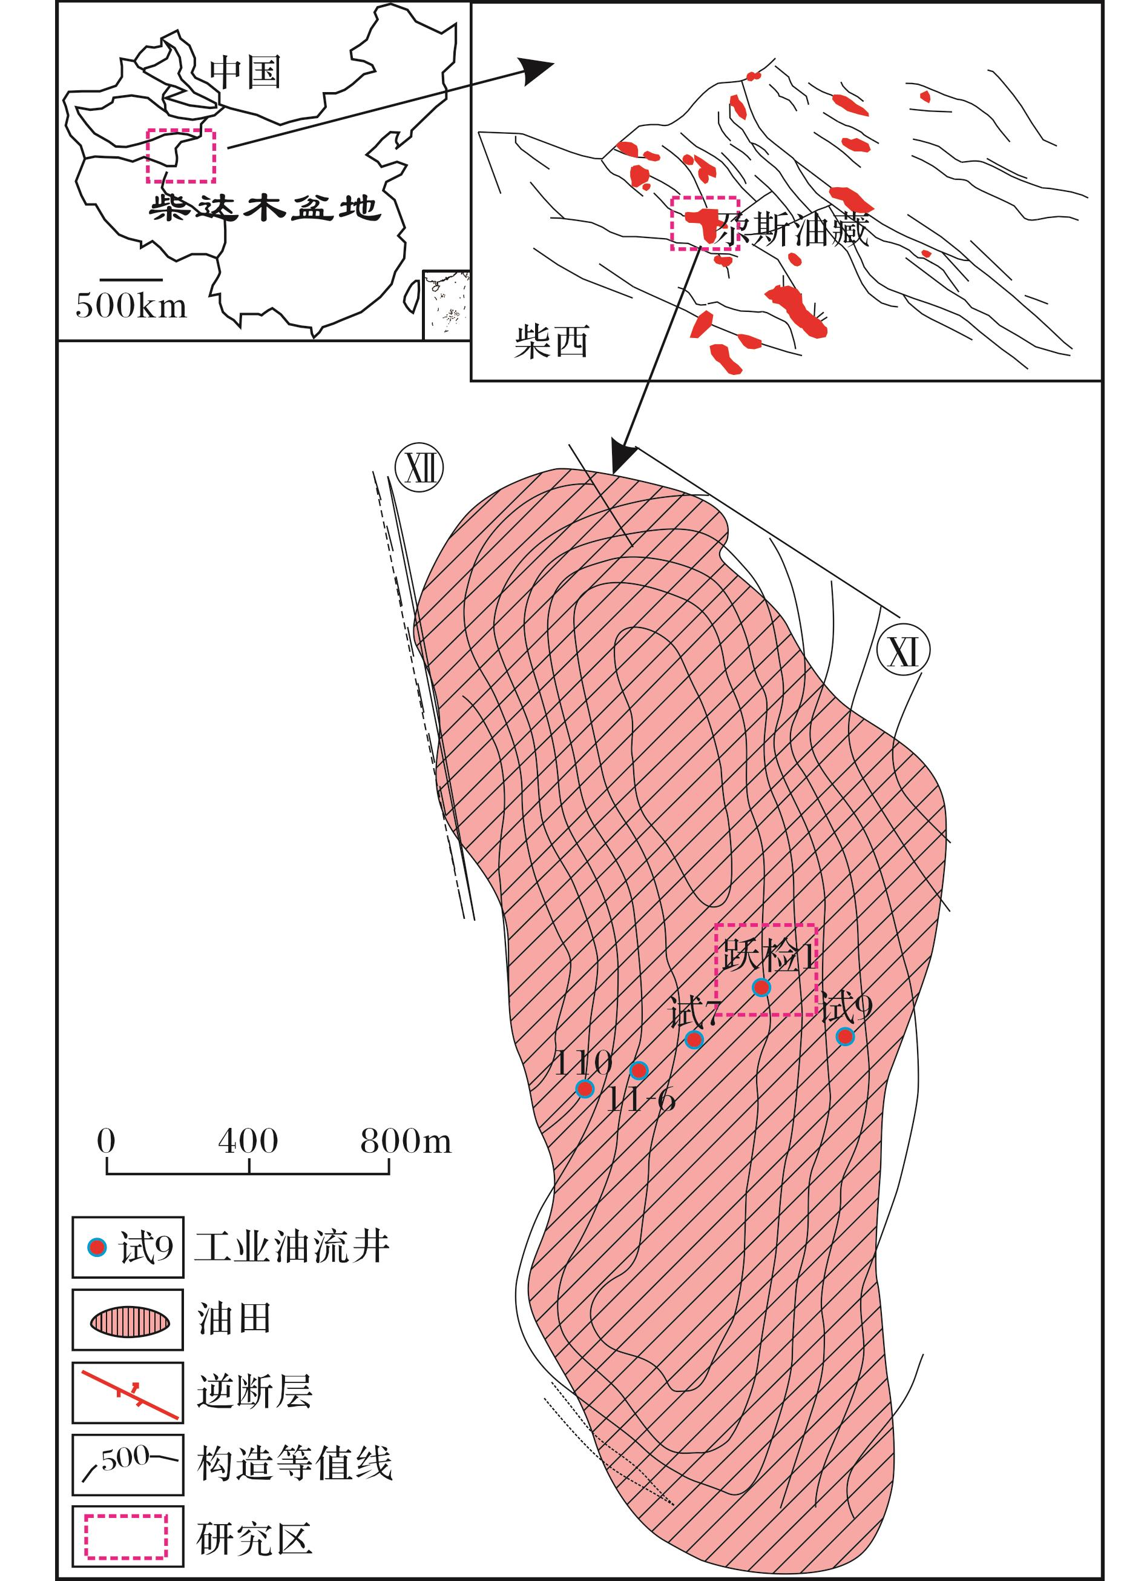
图1 尕斯油田构造位置^{[25]}
Fig.1 Simplified geological map of the Gasi Oilfield, Qaidam Basin,western China ^{[25]}
Gui Lili,Zhao Mengjun,Liu Keyu,et al.Reservoir fluid evolution and hydrocarbon charge history of the Gasi E<sup>1</sup><sub>3</sub> Oilfield,southwestern Qaidam Basin[J].Natural Gas Geoscience,2016,27(2):289-297,319.[桂丽黎，赵孟军，刘可禹，等.柴达木盆地尕斯地区古近系砂岩储层流体—成藏演化特征[J].天然气地球科学，2016,27(2):289-297,319.]

