Slide 1
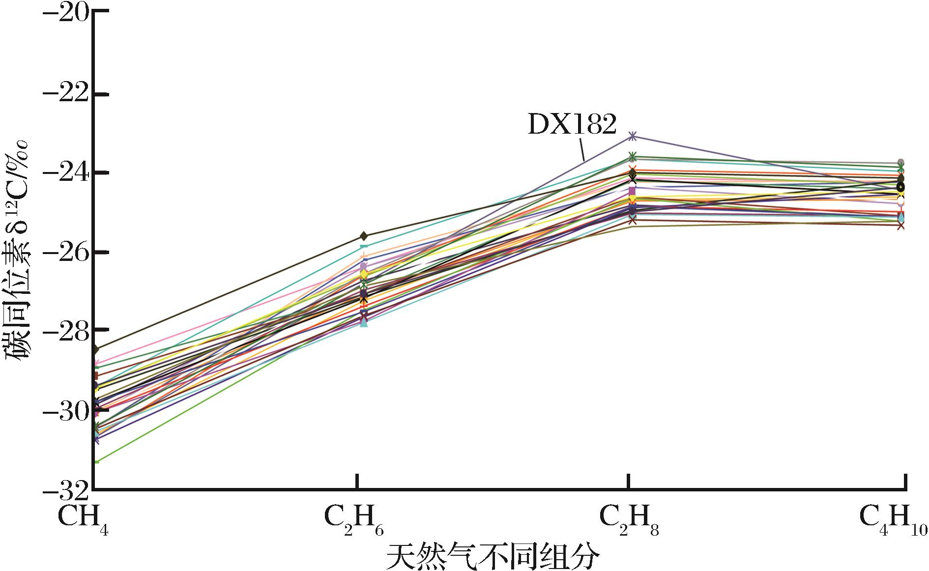
图8 准噶尔盆地克拉美丽滴西地区天然气同位素组成特征
Fig.8 Isotope distribution patterns for the C₁-C₅ hydrocarbons from natural gas in the Kelameili Gasfield
Xiang Caifu,Wang Xulong,Wei Lichun,et al.Origins of the natural gas and its migration and accumulation pathways in the Kelameili Gasfield[J].Natural Gas Geoscience,2016,27(2):268-277.[向才富,王绪龙，魏立春，等.准噶尔盆地克拉美丽气田天然气成因与运聚路径[J].天然气地球科学，2016,27(2):268-277.]

