Slide 1
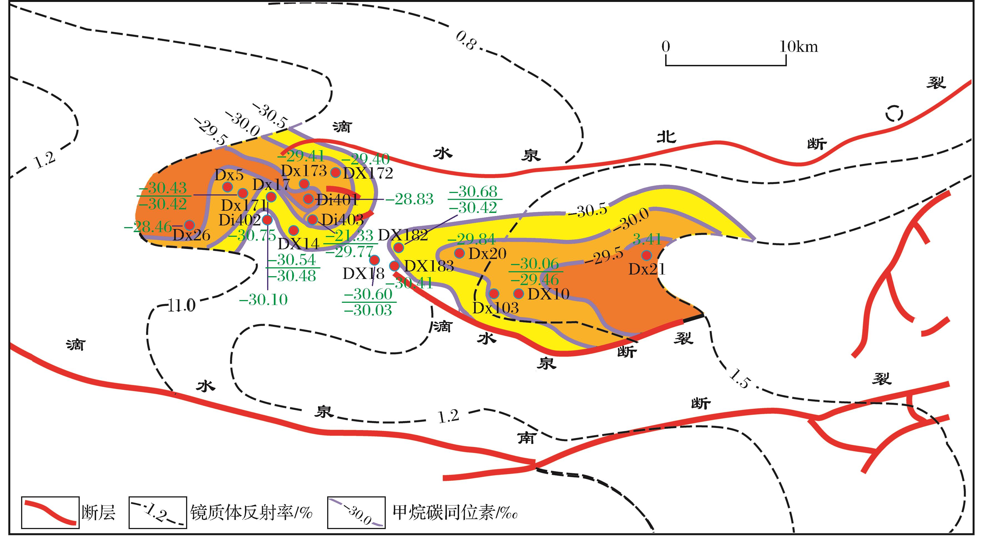
图7 克拉美丽滴西地区天然气甲烷碳同位素平面分布特征
Fig.7 Horizontal distribution of the methane isotope from the natural gas found in the Kelameili Gasfield
Xiang Caifu,Wang Xulong,Wei Lichun,et al.Origins of the natural gas and its migration and accumulation pathways in the Kelameili Gasfield[J].Natural Gas Geoscience,2016,27(2):268-277.[向才富,王绪龙，魏立春，等.准噶尔盆地克拉美丽气田天然气成因与运聚路径[J].天然气地球科学，2016,27(2):268-277.]

