Slide 1
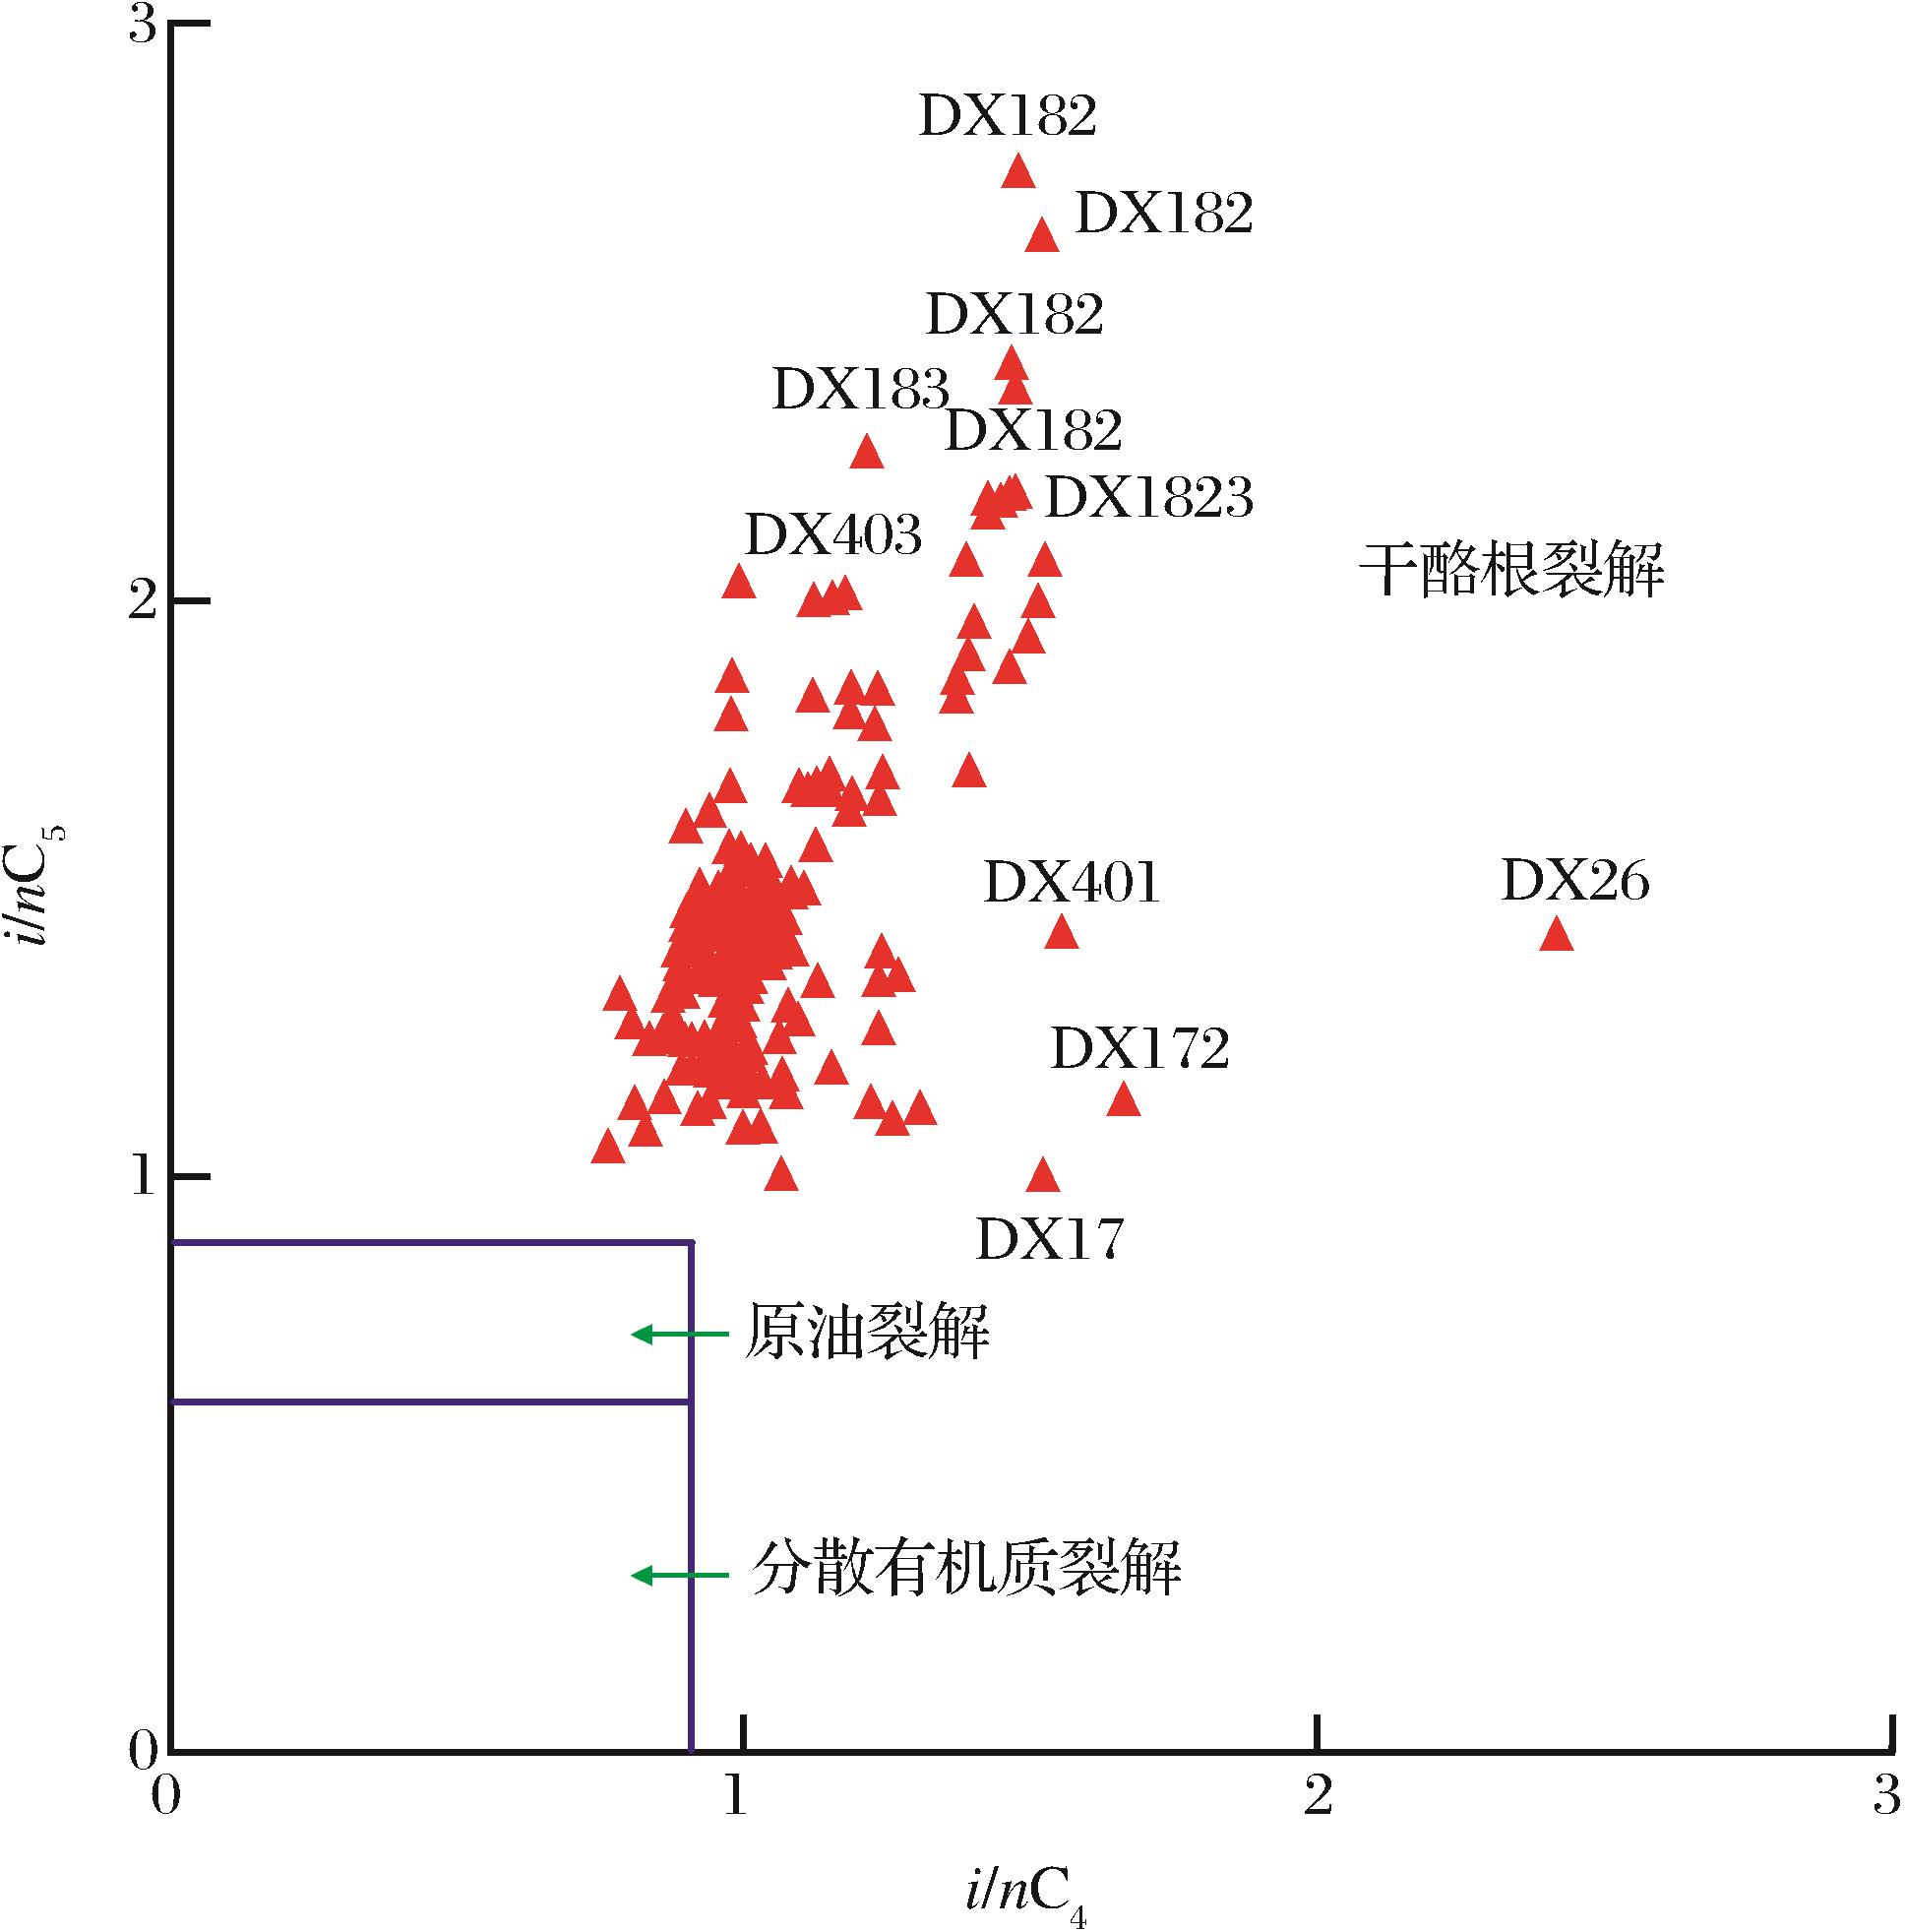
图3 克拉美丽气田天然气成因类型判别模板(模板据Prinzhofer 等 ^{[27]})
Fig.3 Genetic types of the natural gas found in the Kelameili Gasfield(model from Prinzhofer et al^{[27]})
Xiang Caifu,Wang Xulong,Wei Lichun,et al.Origins of the natural gas and its migration and accumulation pathways in the Kelameili Gasfield[J].Natural Gas Geoscience,2016,27(2):268-277.[向才富,王绪龙，魏立春，等.准噶尔盆地克拉美丽气田天然气成因与运聚路径[J].天然气地球科学，2016,27(2):268-277.]

