Slide 1
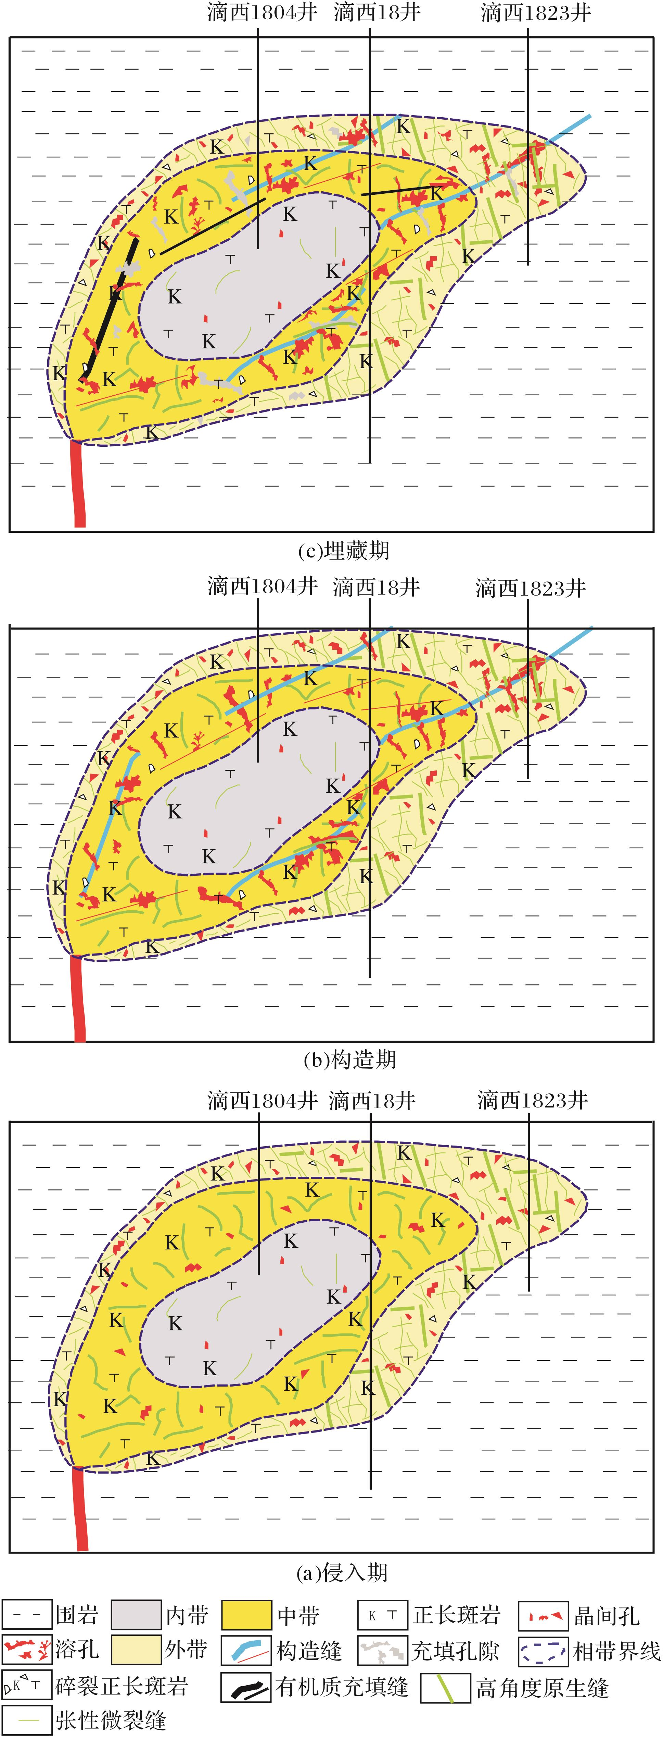
图7 次火山岩储层形成及演化过程示意
Fig.7 Formation and evolution of subvolcanic reservoir in well Dixi 18 area
Liu Xiaohong,Feng Mingyou,Xi Aihua，et al.Formation and evolution of the reservoir space of subvolcanic reservoir:A case study of the well Dixi 18 area in Kelameili Gasfield[J].Natural Gas Geoscience,2016,27(2):278-288.[刘小洪，冯明友，郗爱华，等.次火山岩储层储集空间形成及演化——以克拉美丽气田滴西18井区为例[J].天然气地球科学，2016,27(2):278-288.]

