Slide 1
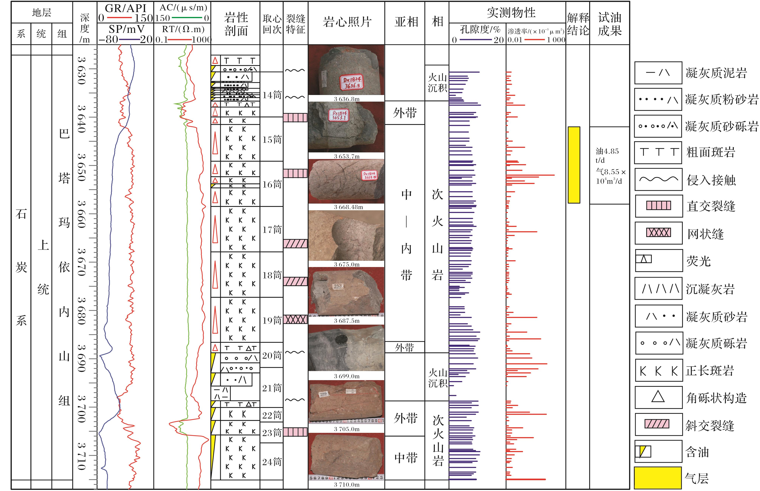
图4 滴西1824井次火山岩储层综合柱状图
Fig.4 Column map of sub-volcanic rock reservoir of well Dixi 1824
Liu Xiaohong,Feng Mingyou,Xi Aihua，et al.Formation and evolution of the reservoir space of subvolcanic reservoir:A case study of the well Dixi 18 area in Kelameili Gasfield[J].Natural Gas Geoscience,2016,27(2):278-288.[刘小洪，冯明友，郗爱华，等.次火山岩储层储集空间形成及演化——以克拉美丽气田滴西18井区为例[J].天然气地球科学，2016,27(2):278-288.]

