Slide 1
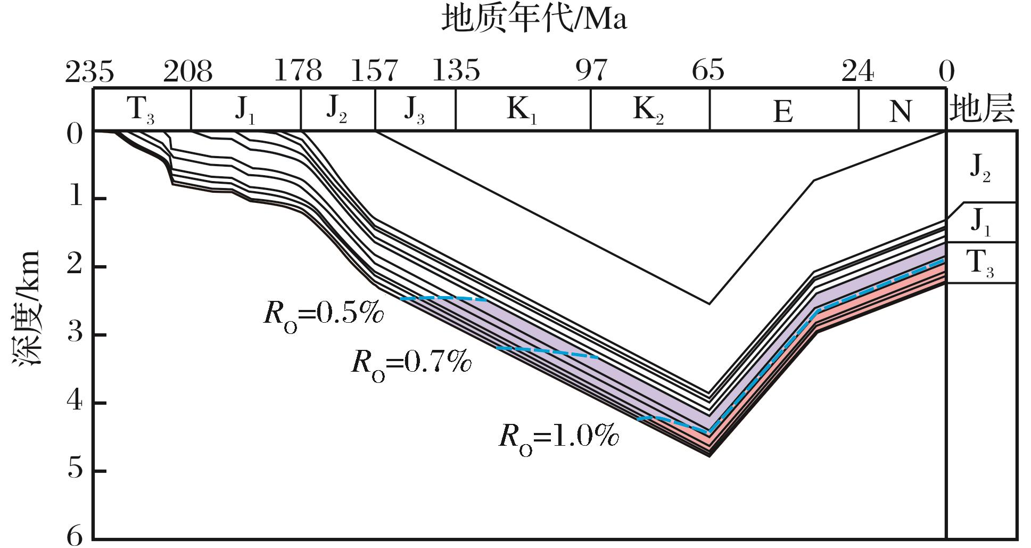
图4 川南地区上三叠统烃源岩生烃史(包62井，据文献[13]修改)
Fig.4 The hydrocarbon-generating history of source rocks in south Sichuan Basin(well Bao 62, modified from reference[13])
Wang Peng,Liu Sibing,Shen Zhongmin,et al.Hydrocarbon accumulation history and its difference of gas reservoirs in Upper Triassic Formation of Sichuan Basin[J].Natural Gas Geoscience,2016,27(1):50-59.[王鹏，刘四兵，沈忠民，等.四川盆地上三叠统气藏成藏年代及差异[J].天然气地球科学，2016,27(1):50-59.]

