Slide 1
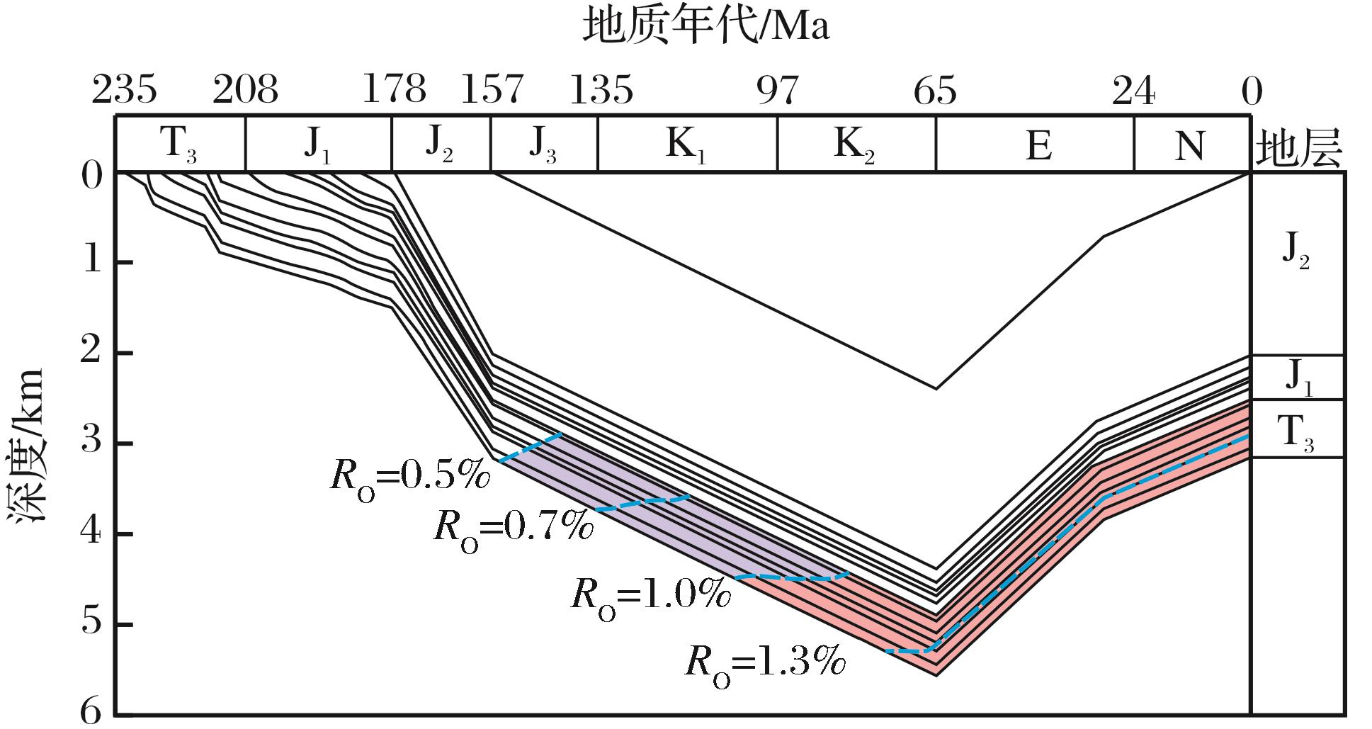
图3 川中地区上三叠统烃源岩生烃史(营S井，据文献[12]修改)
Fig.3 The hydrocarbon-generating history of source rocks in middle Sichuan Basin(well Ying S,modified from reference[12])
Wang Peng,Liu Sibing,Shen Zhongmin,et al.Hydrocarbon accumulation history and its difference of gas reservoirs in Upper Triassic Formation of Sichuan Basin[J].Natural Gas Geoscience,2016,27(1):50-59.[王鹏，刘四兵，沈忠民，等.四川盆地上三叠统气藏成藏年代及差异[J].天然气地球科学，2016,27(1):50-59.]

