Slide 1
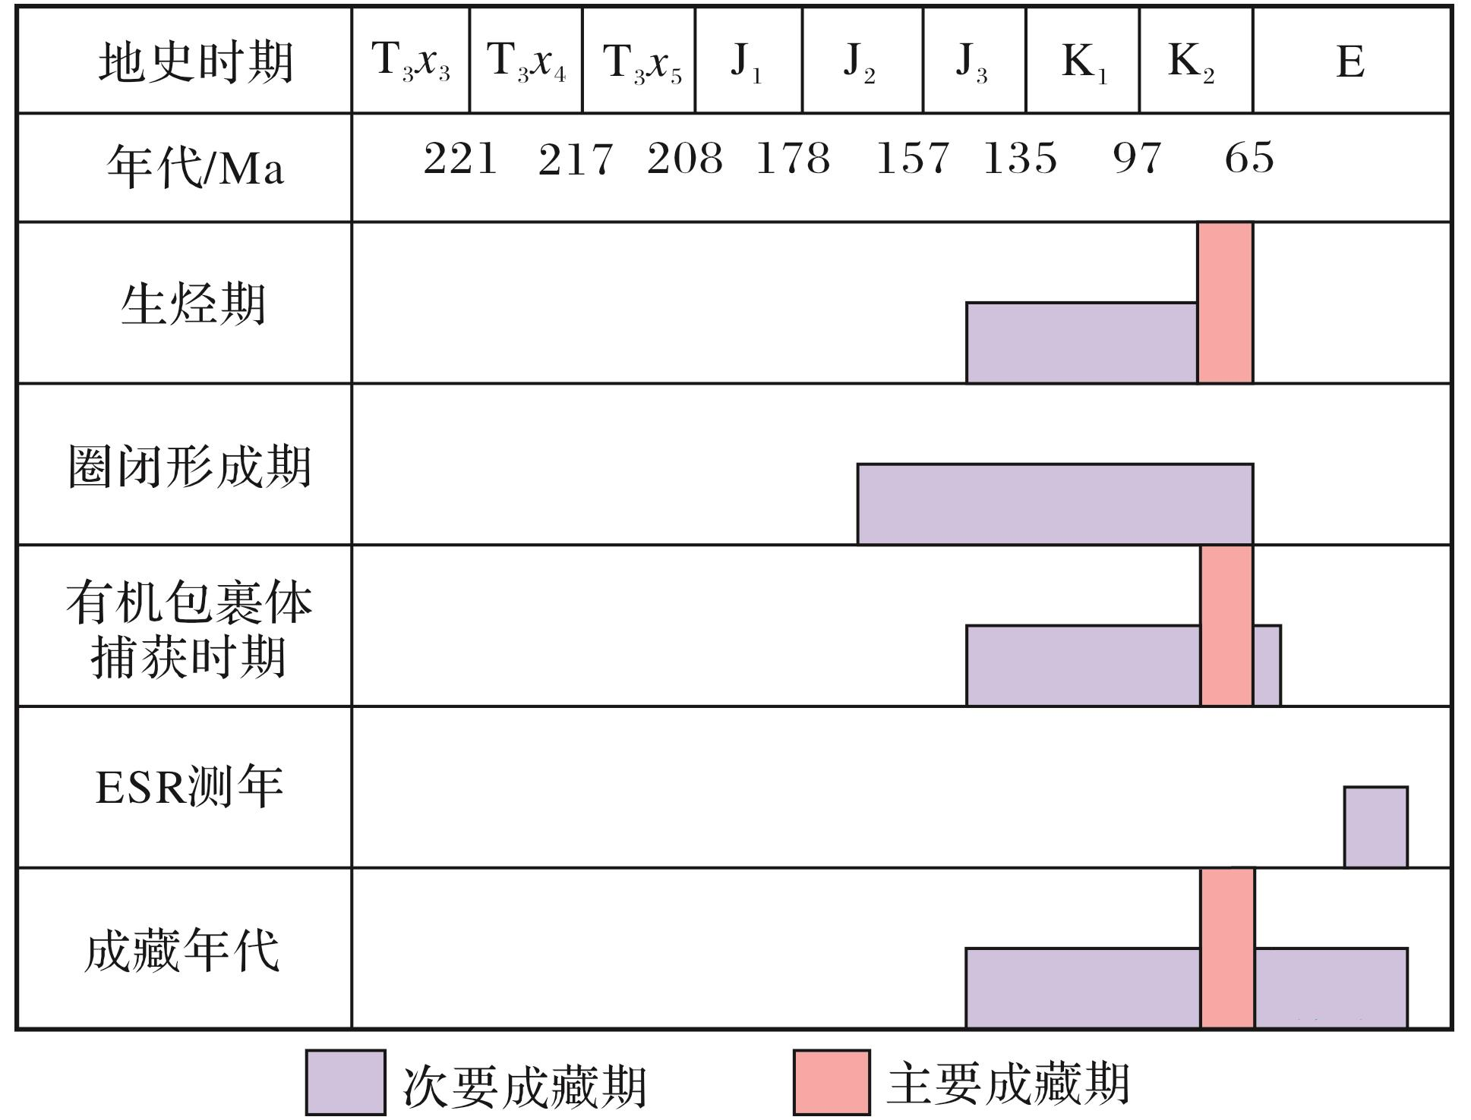
图10 川南地区上三叠统气藏成藏年代
Fig.10 Hydrocarbon accumulation history of Upper Triassic gas reservoir in south Sichuan Basin
Wang Peng,Liu Sibing,Shen Zhongmin,et al.Hydrocarbon accumulation history and its difference of gas reservoirs in Upper Triassic Formation of Sichuan Basin[J].Natural Gas Geoscience,2016,27(1):50-59.[王鹏，刘四兵，沈忠民，等.四川盆地上三叠统气藏成藏年代及差异[J].天然气地球科学，2016,27(1):50-59.]

