Slide 1
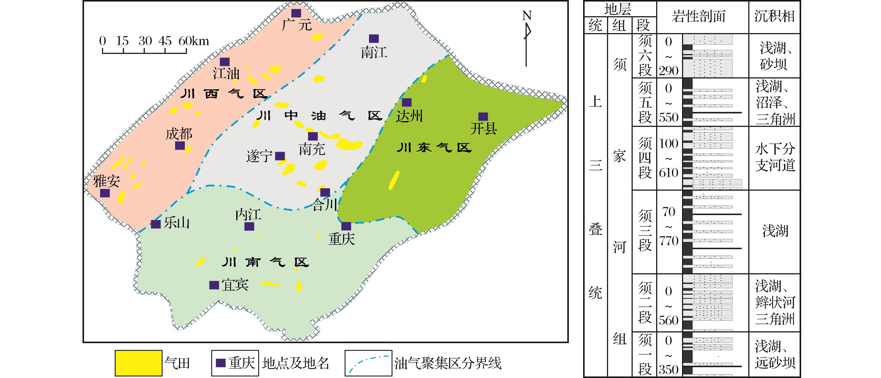
图1 四川盆地油气聚集区划分及上三叠统气田分布(据文献[7]修改)
Fig.1 The distribution of hydrocarbon accumulation zone and gasfields of the Upper Triassic in Sichuan Basin(modified from reference[7])
Wang Peng,Liu Sibing,Shen Zhongmin,et al.Hydrocarbon accumulation history and its difference of gas reservoirs in Upper Triassic Formation of Sichuan Basin[J].Natural Gas Geoscience,2016,27(1):50-59.[王鹏，刘四兵，沈忠民，等.四川盆地上三叠统气藏成藏年代及差异[J].天然气地球科学，2016,27(1):50-59.]

