Slide 1
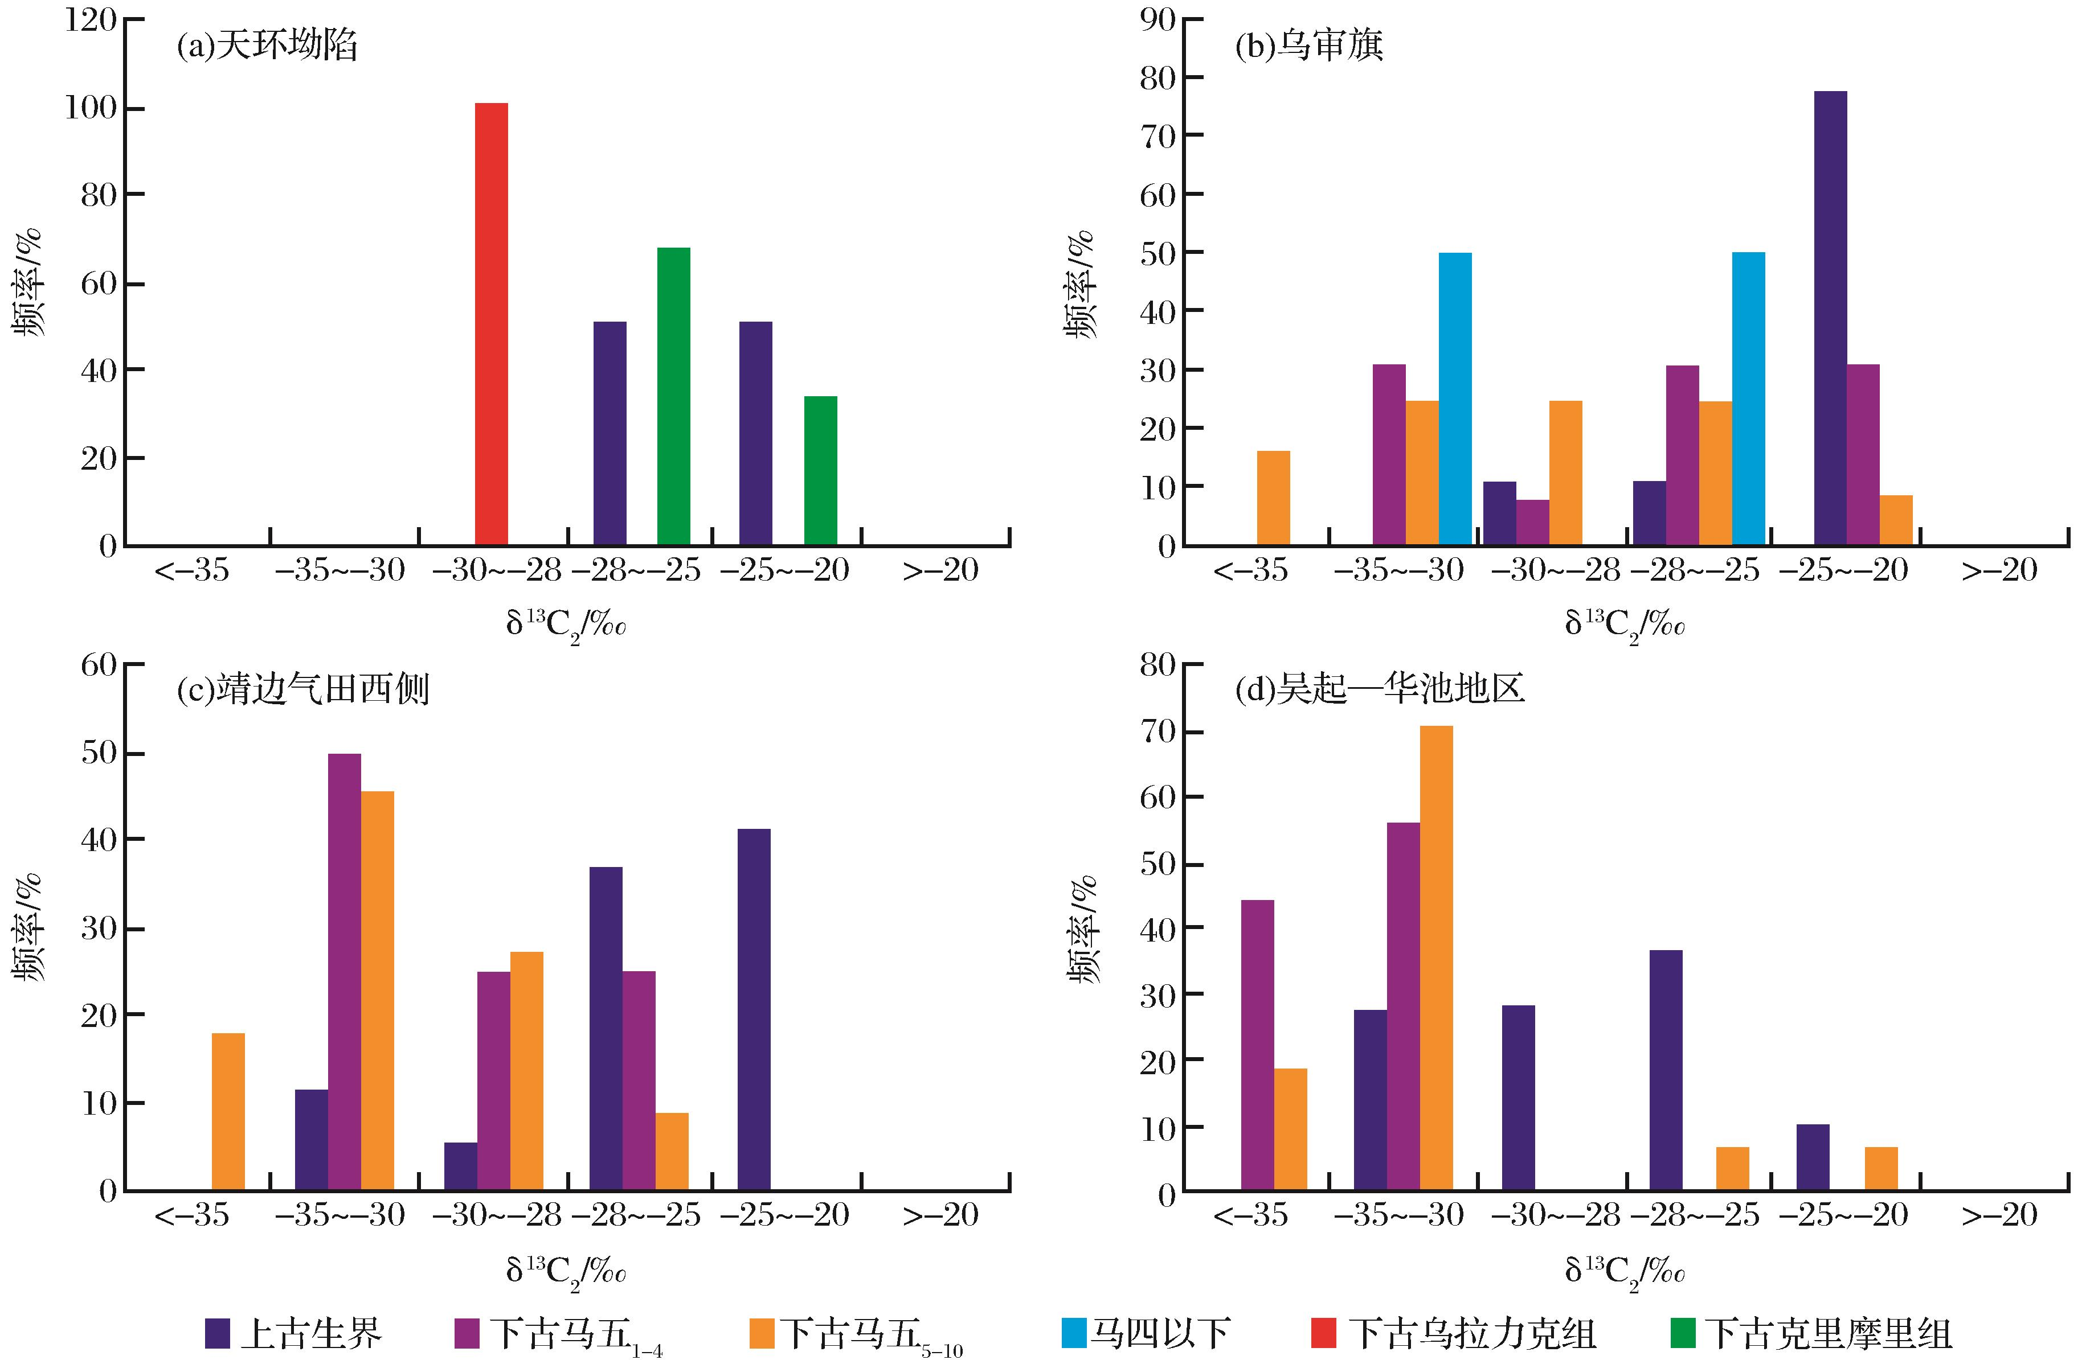
图3 靖西地区古生界天然气δ¹³C₂频率分布
Fig.3 Frequency histogram of δ¹³C₂ of Paleozoic natural gas to the west of Jingbian Gasfield
Kong Qingfen,Zhang Wenzheng,Li Jianfeng,et al.Origin of natural gas in Ordovician in the west of Jingbian Gasfield,Ordos Basin[J].Natural Gas Geoscience,2016,27(1):71-80.[孔庆芬，张文正，李剑锋，等.鄂尔多斯盆地靖西地区下古生界奥陶系天然气成因研究[J].天然气地球科学，2016,27(1):71-80.]

